Slide 1
IBM University Engagement Project Submission
“Exploring the Power of Agentic AI with IBM Granite and LangFlow”

Slide 2

Project Tile – Interview-Trainer-Agent
Domain of Project – Artificial Intelligence (AI)
Student Name | Recent Passport Photo | Email ID | Mobile number [WhatsApp]
Mandagiri Venkata Surya Narayana Naidu |  | suryamv5936@gmail.com | 7337437930

Slide 3
Problem Statement -
Problem Statement : – Interview Trainer Agent
The Challenge – An Interview Trainer Agent, powered by RAG (Retrieval-Augmented Generation),prepares users for job interviews by generating tailored question sets and preparation strategies based on their profile name, experience level, and job role.
It retrieves role-specific interview questions, industry expectations, behavioral scenarios, and HR
guidelines from recruitment portals, professional networks, and company interview databases.
Users can input their resume or job title, and the agent provides targeted questions, model answers,and improvement tips.It supports both technical and soft skill assessment, ensuring a comprehensive interview prepare experience.
This AI-driven assistant builds user confidence, sharpens responses, and increases success rates in competitive hiring environments.
Technology – Use of IBM Cloud Lite services / IBM Granite is mandatory.

Slide 4
Proposed Solution -
Proposed System Solution
Develop an AI-powered Interview Trainer Agent using IBM Granite and Retrieval-Augmented Generation (RAG) on IBM Cloud Lite.
Analyze the user's resume, skills, experience, and target job role to personalize interview preparation.
Retrieve relevant interview questions, HR guidelines, and company-specific content from a vector database using semantic search.
Generate technical, HR, behavioral, and coding interview questions along with model answers and preparation tips using IBM Granite.
Conduct interactive mock interviews and evaluate user responses with detailed feedback and scores.
Provide a comprehensive interview readiness report highlighting strengths, weak areas, and personalized learning recommendations.

Slide 5
Technology Used
IBM Cloud Lite – Cloud platform
IBM watsonx.ai (IBM Granite) – AI model for interview generation
LangChain – RAG pipeline
ChromaDB / IBM watsonx.data – Vector database
Python & FastAPI – Backend development
React.js + Tailwind CSS – Frontend development
PyMuPDF – Resume parsing
IBM Cloud Object Storage – File storage
SQLite / PostgreSQL – Database
Git & GitHub – Version control

Slide 6









Core Objectives
Analyze Resumes
Retrieve Knowledge
Conduct Interviews
Evaluate Responses
Extract core skills, experience levels, and project highlights using PyMuPDF to establish the candidate's unique professional profile.
Perform semantic search across thousands of interview documents using vector embeddings to find the most relevant question frameworks.
Engage the user in a dynamic, chat-based mock interview generating highly tailored technical and behavioral questions via IBM Granite.
Assess candidate answers using the STAR method, providing actionable feedback, comprehensive scoring, and a final PDF readiness report.

Slide 7
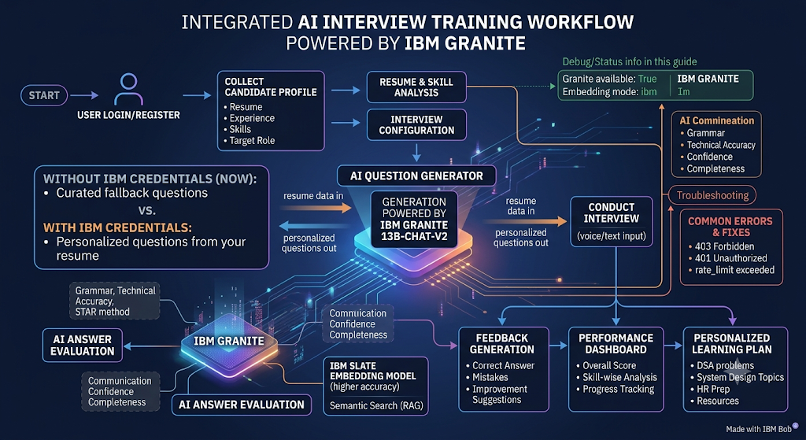
Workflow -

Slide 8
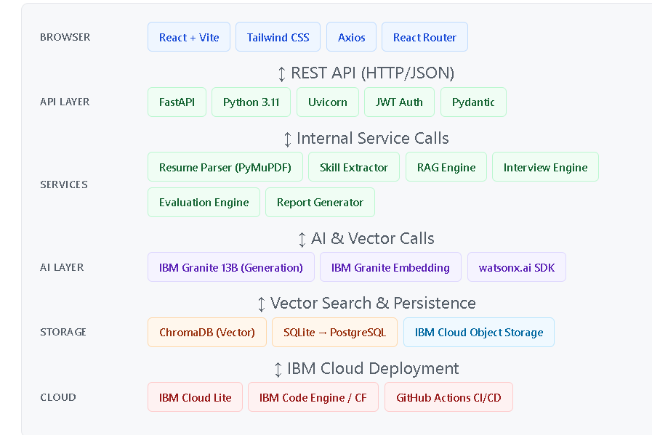
Architecture blueprint

Slide 9

Role of Agentic AI in AI Interview Training Agent
Resume Analysis Agent
Analyzes the candidate's resume.
Identifies skills, projects, experience, and ATS score.
🎯 Interview Planning Agent
Selects interview type (HR, Technical, Coding).
Adjusts difficulty based on user profile and previous performance.
❓ Question Generation Agent
Generates role-specific interview questions.
Creates follow-up questions based on candidate responses.
📝 Answer Evaluation Agent
Evaluates technical accuracy and completeness.
Assesses communication skills and confidence.
📊 Feedback Agent
Provides detailed strengths and improvement areas.
Suggests the correct approach and learning resources.

Slide 10
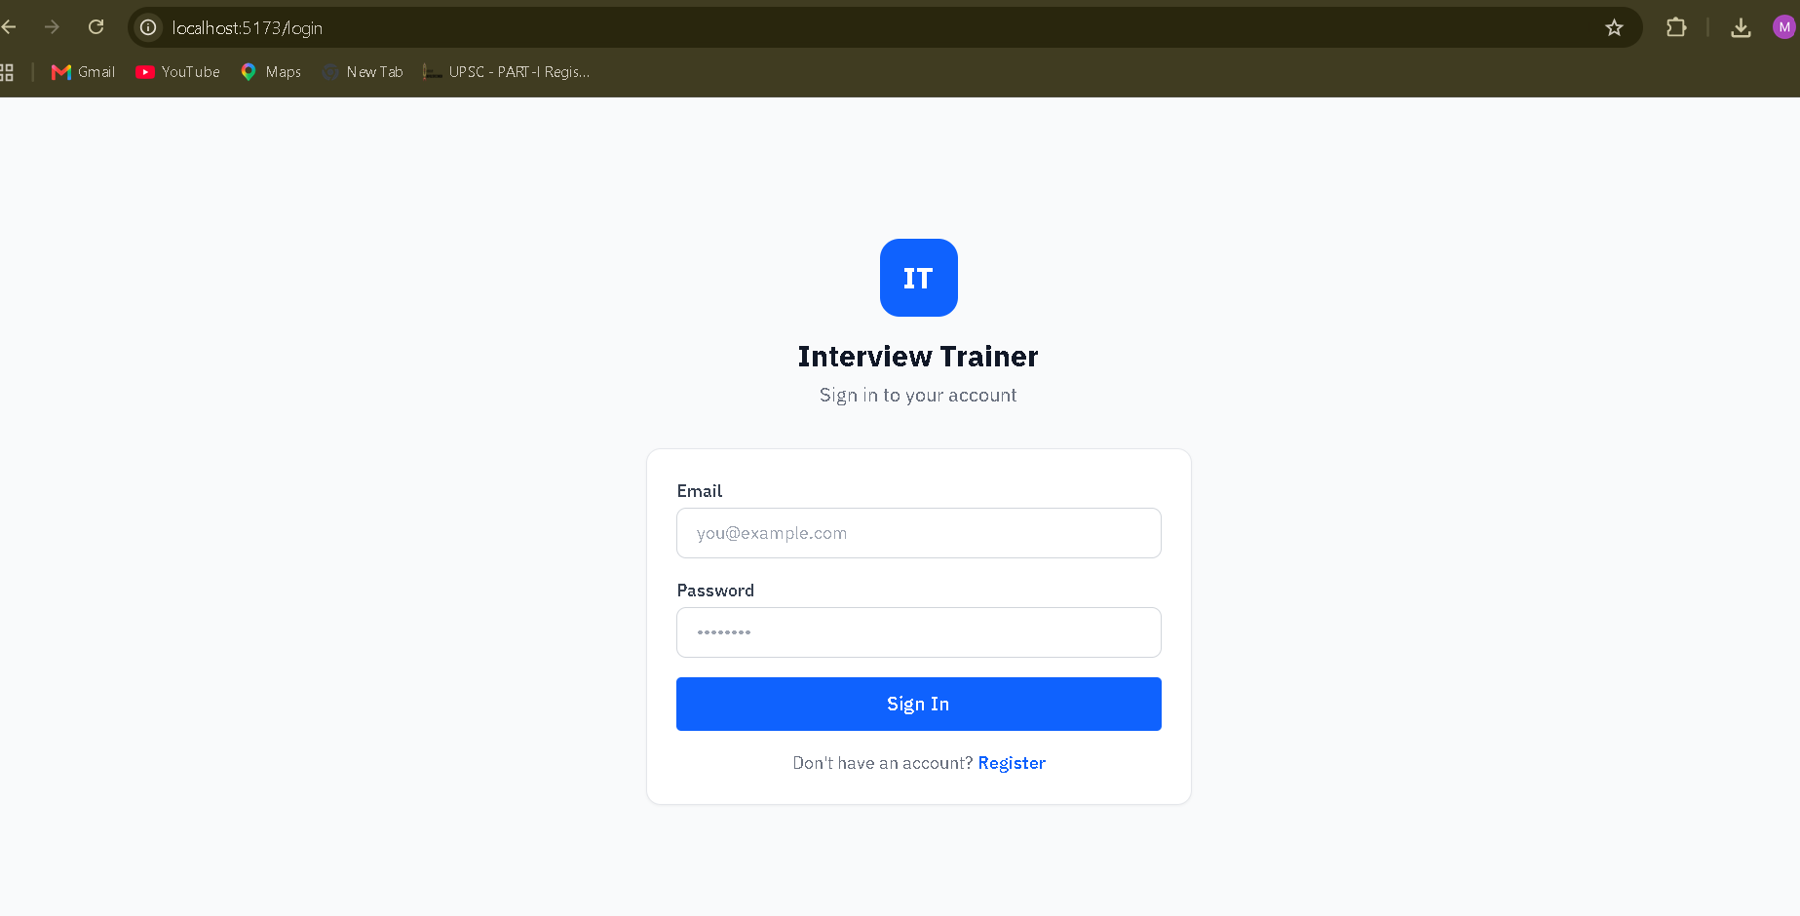
Candidate Login Page

Slide 11
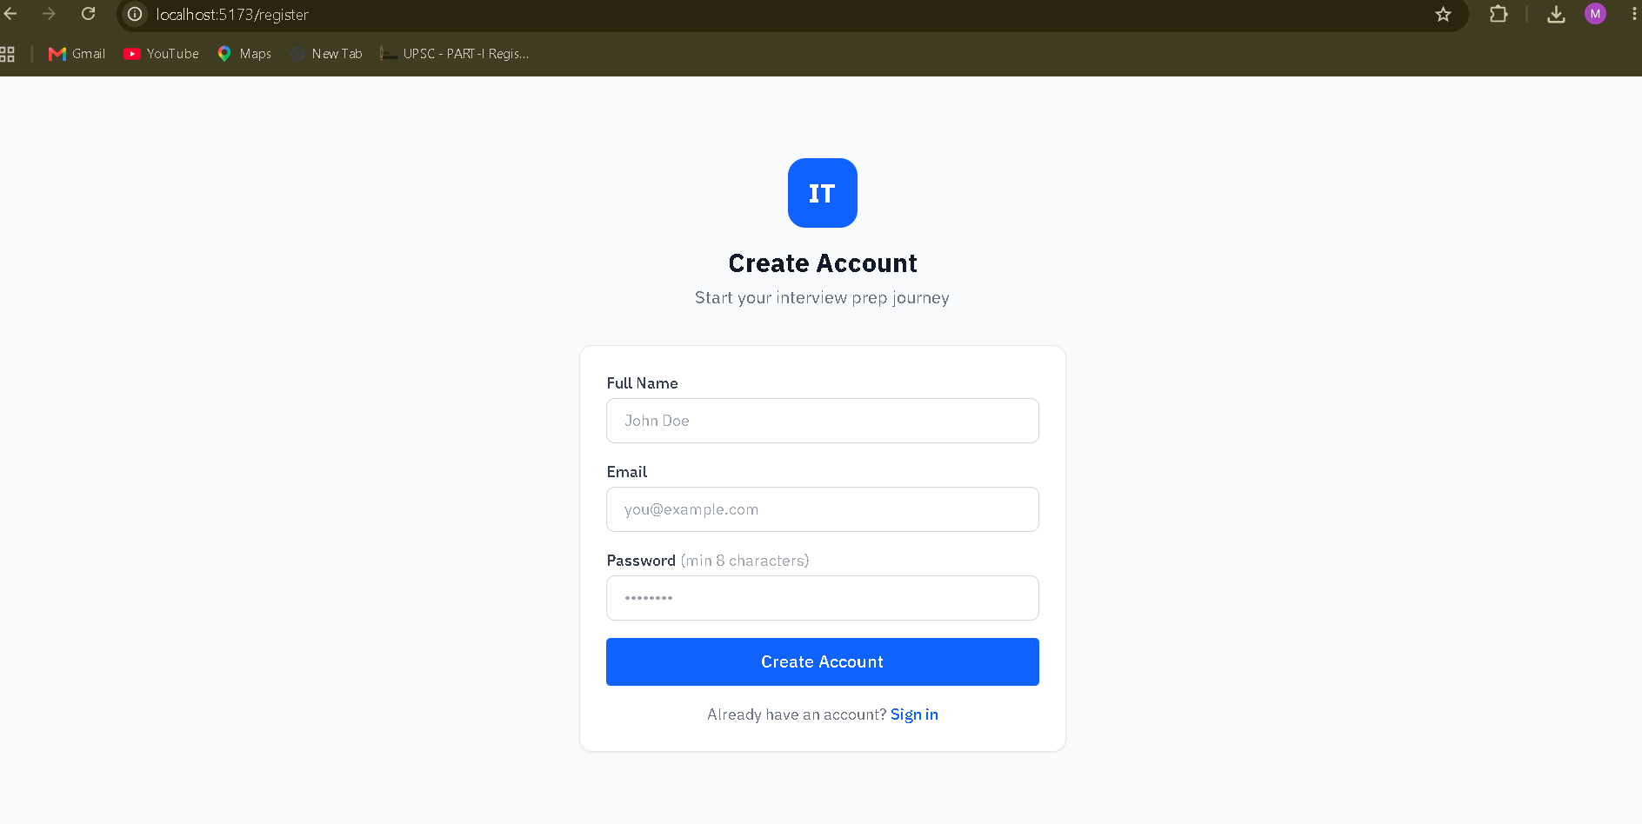
Candidate Registration page

Slide 12
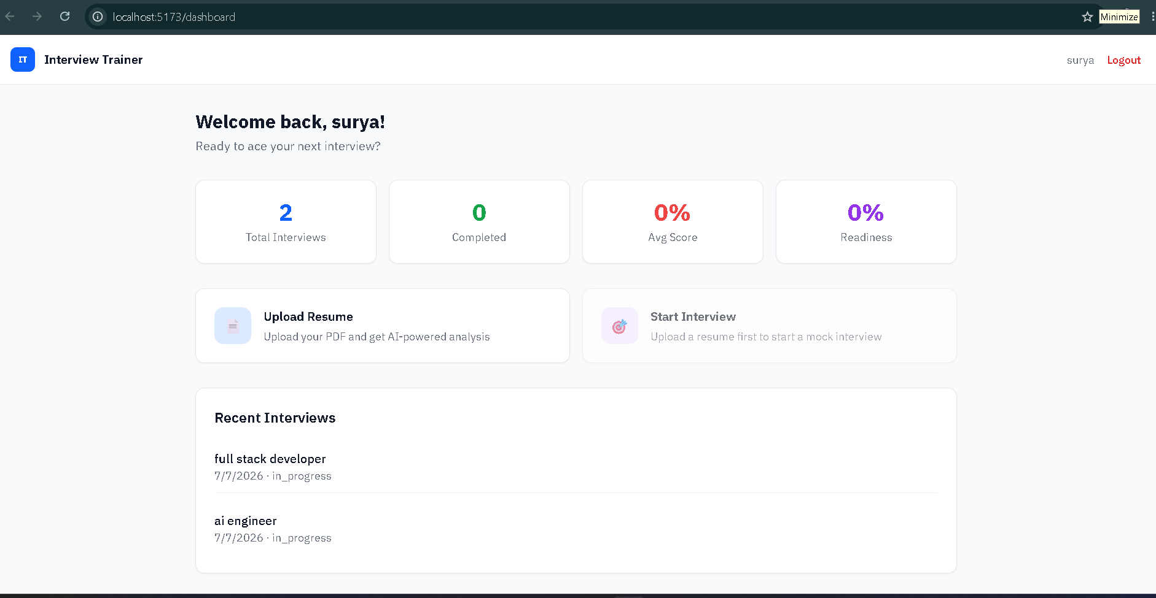
Candidate Dashboard

Slide 13
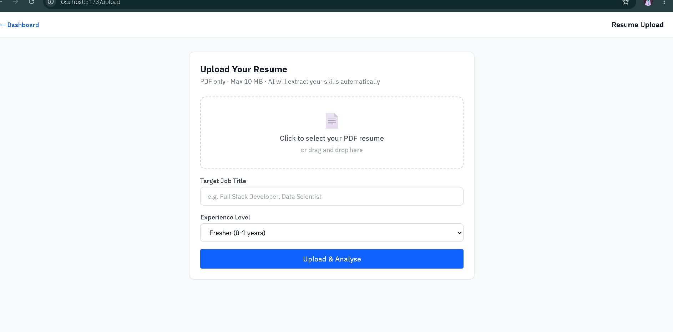
Candidate Resume uploading page

Slide 14
Novelty and Uniqueness
AI-powered adaptive interview system that dynamically adjusts question difficulty based on the candidate's performance.
Personalized interview experience using resume analysis, skills, experience, and target job role.
Real-time answer evaluation with instant feedback on technical accuracy, communication, and confidence.
Integrated ATS resume analysis to identify skill gaps and improve job readiness before interviews.
Personalized learning roadmap that recommends DSA topics, coding problems, and interview resources based on weaknesses.
Support for multiple interview types, including HR, technical, coding, and scenario-based interviews on a single platform.
Detailed performance analytics with progress tracking and skill-wise improvement reports.
AI-generated follow-up questions to simulate a natural and realistic interview conversation.
Scalable multi-agent architecture, where specialized AI agents handle resume analysis, question generation, evaluation, and feedback independently.
Continuous learning support, transforming the platform from a mock interview tool into a complete interview preparation assistant.

Slide 15
Git Hub Link
·
Github URL –https://github.com/Surya733M/interview-trainer
·
·

Slide 16
Future Scope
🎤 Voice-Based Mock Interviews with AI-powered speech evaluation.
💻 Live Coding Assessment with an integrated code editor and compiler.
📄 AI Resume Analyzer for ATS optimization and role-specific resume suggestions.
🎯 Company-Specific Interview Preparation (Google, Microsoft, Amazon, TCS, Infosys, etc.).
🧠 Personalized Learning Roadmap based on performance and skill gaps.
📊 Performance Analytics Dashboard to track progress and interview history.
🤖 Multi-Agent AI System for resume analysis, question generation, evaluation, and feedback.
🌐 Multilingual Interview Support for regional and international candidates.
☁️ Cloud-Based Deployment for secure, scalable, and remote access.
🎓 Career Guidance & Job Recommendations with certification and learning suggestions.
·
·

Slide 17
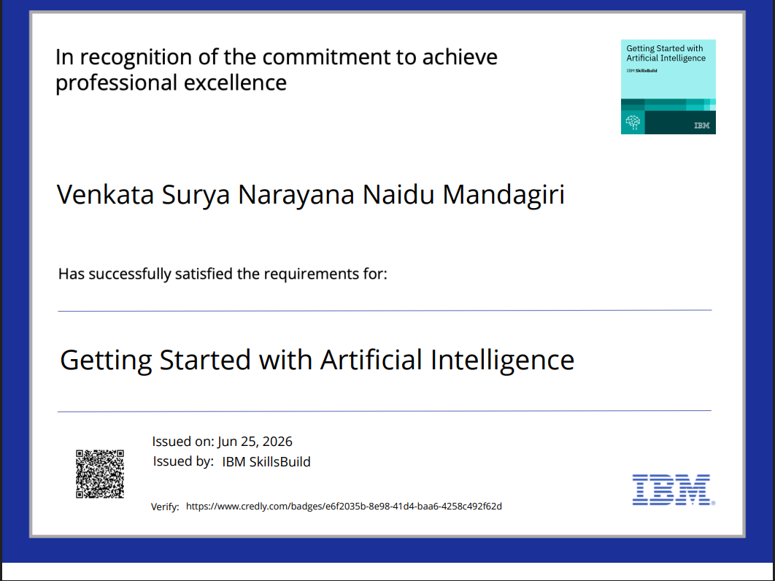
Certificates Earned:

Slide 18
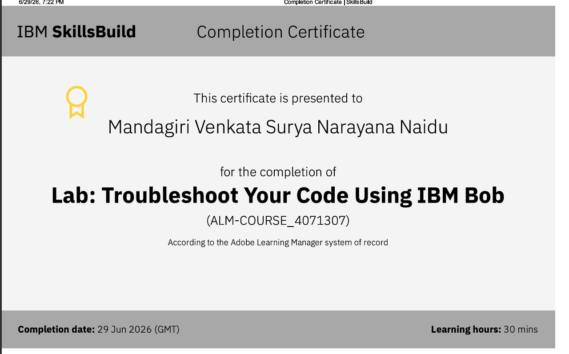
Certificates Earned:​

Slide 19


